Slide 1

Building resilience in a complex world
Pip Haydock – The 2Gether Partnership

Slide 2
A few questions before we start…
1. What does resilience mean to you?
2. How do you know you have it?
3. How do you know when you don’t?
4. Why does it matter?
5. Can we do anything to make us more
resilient?

Slide 3
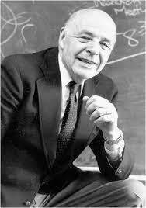
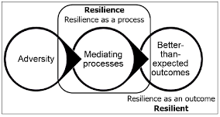
What is Resilience?
Garmezy (1973)
Psychological Resilience is defined as “an individual’s ability to properly adapt to stress and adversity”
Or sometimes termed how well you “bounce back”
From challenges that come your way…

Slide 4
How do you know if you’re Resilient..
Or not so?
Spectrum of Behaviors
from
Highly Resilient to Mal-functioning
Depressed
Anxious
Paranoid
Eating Issues
Alcohol reliance
Drug Taking
Gambling
Self Harming
Quiet
Absent
Tearful
Unreliable
Negative
Angry
Unfriendly
Tired
Sleepless
Anxious
Stressed
Down
Anti-Social
Inflexible
Positive
Expectations
Optimistic
Personal
Control
Expressive
Friendly
Self Confident
Positive
Adaptive
Playful
High Self Esteem
Flexible
Positive
Can-do
Empathic
Sympathetic
Good Friendships

Slide 5
Why are we at times more resilient than others?

Slide 6
Why are we sometimes more resilient than others?… factors include….
Sleep – kids/ dogs/neighbours kept you awake/working late or long shifts
Eating /drinking too many unhealthy things
Lack of physical activity - enough exercise
Worry about family/ job/ health
Too much going on / how in control we feel/ too much change…

Slide 7
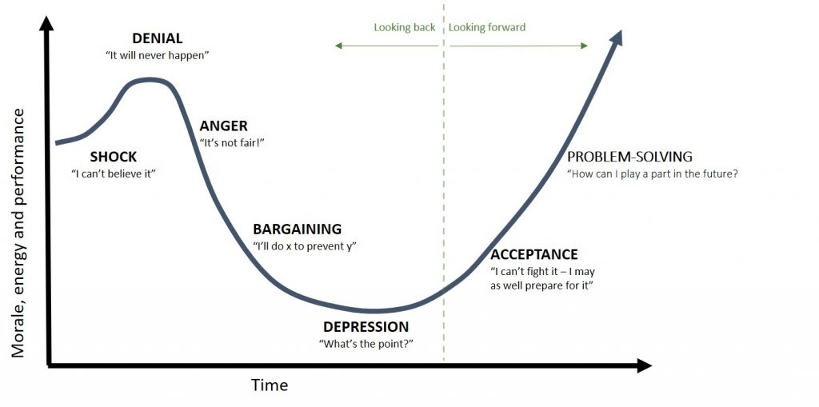
The Covid 19 Change Curve Example…..
Your resilience can be a factor of how much change is going on around you
The Human response to change example…
Adapted from
Elizabeth Kubler-Ross
Shock & lots of energy: “It’s coming our way… let’s get hyper organized incase there’s a lock down… buy loo roll, pasta, tins of tomatoes and we will be fine…! I’m quite enjoying the loo roll banter actually … who would have thought “
Denial: “A lock down … for 3 weeks… you can’t be serious!? Kids off school.. Just for a week or two… not until June
surely?
Anger: Why should our families have to suffer because someone ate a bat…?! Why did people have to travel and bring it here?! We should have acted sooner! Why do schools have to close.. Me a teacher… no top of everything else?
Bargaining: So can we still go to the beach or the park can’t we? It doesn’t have to be a strict lock down does it..? I could go and visit somewhere by car and have a mini holiday… to Fife… to Arran… to Cornwall…to Wales ..to the Highlands and Islands..? If I don’t talk to or look at anyone it won’t be like a real holiday and I promise not to enjoy it too much!
Depression: “No…. It’s a real lock down”. “The parks were full… I wish I’d gone out/ not gone out” “the virus is coming our way”… “I don’t feel well.. I can’t smell anything… is this a new cough or an old one?” “Now I have no business, how I will I survive?” “Someone my age got it… My friend’s granny is ill…” “People will think I’m a failure if my business goes under…” “I liked my life the way it was, I know I moaned, it wasn’t this bad though”…
Acceptance: Maybe I just stay in and watch that Netflix box set, sort out my website/ garage/ kitchen cupboards. I will become a volunteer.
Problem Solving: “I’ll join some networking groups, invest in personal development & do things I never normally have time to do.” “ Let’s get fit… let’s bake…This won’t last forever… best make the most of it…….” ..etc. etc.

Slide 8

Resilience can be a function of…
HOW I INTERPRET THE WORLD!

Slide 9
Building Resilience by looking at the world in a positive way
Looking back at the past and reflecting upon other times of adversity and how you have overcome them/ what you learned and what can help you now from that past experience
…’Life-line exercise’

Slide 10
Try the ‘Life line’ activity to remind yourself … you have had tough times before and you came through it… and you will do again
Get some paper & a pen… different colours help but are not essential
Draw 2 axis of a graph…vertical are the highs and lows of your life, the horizontal is time
Choose a time period… it could be your whole life, it could be between two significant points in time where there was challenge around
You might decide to do two lines … one for home and one for work
Draw in the highs and the lows
When you have finished notice:
what did you learn at the time or have you learned as a result of the exercise?
What was/ is important to you
What values were/ are important to you?
Which of the above can help you in your current difficult situation?

Slide 11
Pip’s top tips for building resilience in yourself
Find your own relaxation techniques… yoga, have a bath, listen to music, focus on your breath, dig the garden, go for a walk…and SET ASIDE TIME TO DO IT
Notice when others (or you) are placing unrealistic demands on yourself
Take up a new interest or hobby… something to take your mind off the day to day
Make time for friends and people that make you laugh/ smile and allow you to talk
Remind yourself of small things you can be grateful for… even if it is as small (or as big) as you are breathing..
Remember times when you have got through tough things before… what did you learn
Take one step at a time… you don’t have to do everything today
Be kind -Treat yourself as a kind friend would. Make your inner self talk that of a kind friend… see next slide…

Slide 12
By Jeff Foster

Slide 13
Thank you and stay well!
pip@the2getherpartnership.com
www.the2getherpartnership.com

